Slide 1
HID Mobile Access® v2
March 2016

Slide 2
Table of Contents
Table of Contents Slide
About HID Global® (3-5)
HID Mobile Access®, powered by Seos (6-14)
HID Mobile Access – Go Mobile? (15-23)
Security and Data Protection (24-25)
Discover and Learn More (29-31)

Slide 3
HID Global: Core Competencies
Secure Manufacturing experience since 1964
High quality level ISO 9001-2008
Mobile Access®,
Powered by Seos®
Global sales, service network and local technical support
Warranties

Slide 4
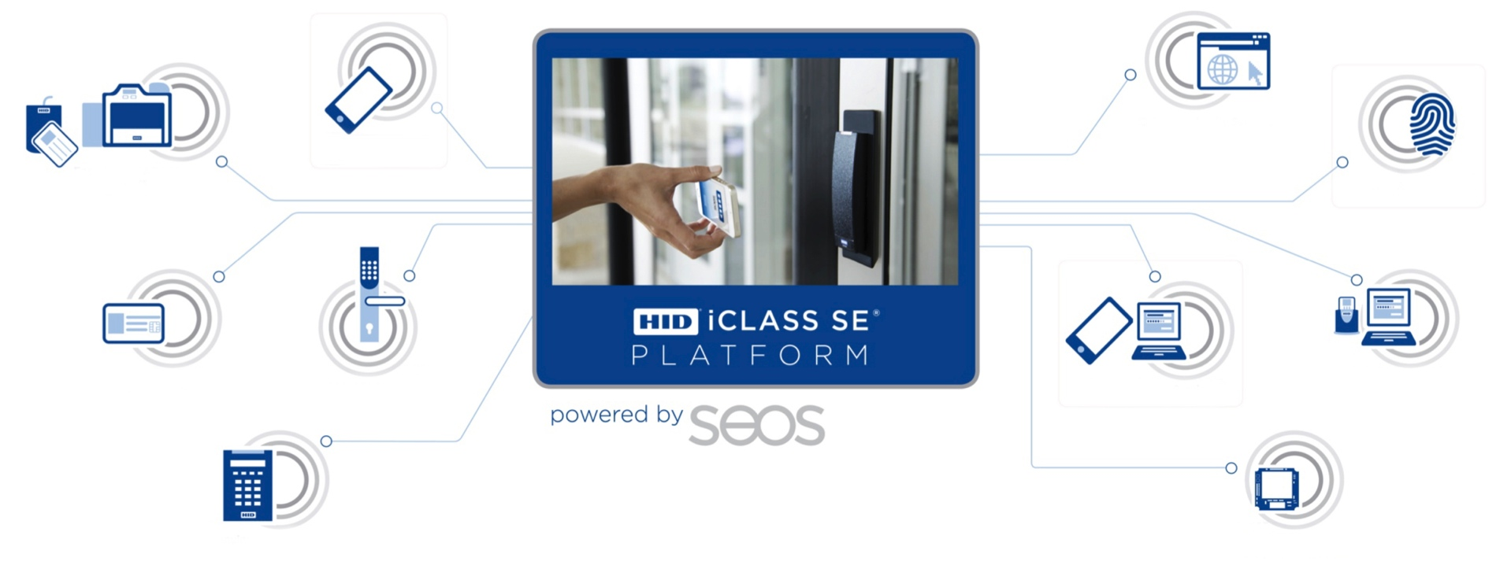
Digitalization
HID Mobile AccessTM Portal
HID Mobile Access®
Quantum Secure PACS Automation
HID Biometrics Solutions
HID® Seos Credentials
ASSA ABLOY Locks
ActivID® Tap Authentication
OMNIKEY® Readers
HID iCLASS SE Readers
Embedded Technologies

Slide 5
HID Mobile Access®, powered by Seos®

Slide 6
The world of access control just evolved. Use your smart device as a secure identity to access the building and much more….

Slide 7
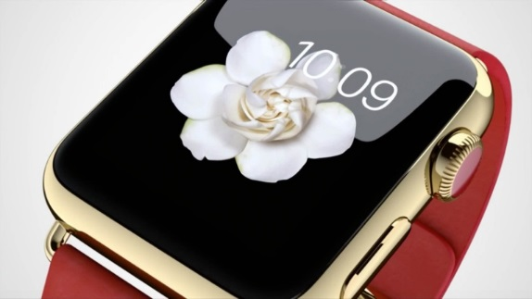
Mobility Trends
In 2019, IDC predict Apple to ship 45.2 million Apple Watches, with Android Wear reaching 34.3 million, Translating to a market share of 51.1% and 38.8% respectively.
IDC Worldwide Wearables Forecast, 2016–2020: January 2016
5.9 billion Smartphones in use by 2020, compared 2.6 billion in 2014.
GSMA Global Mobile Economy Report 2015

Slide 8
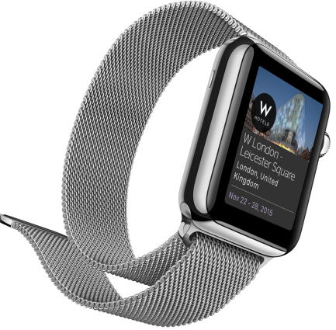
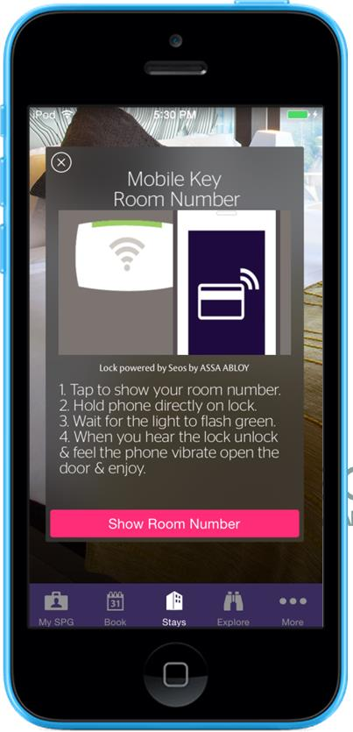
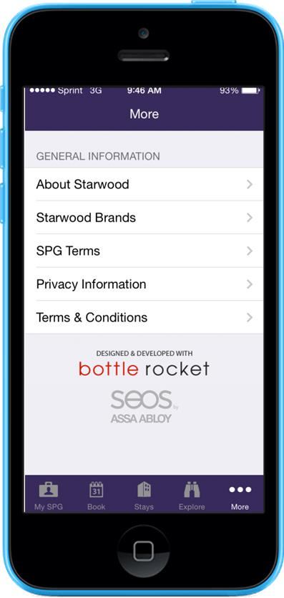
Mobile Access, Powered by Seos
Breakthrough Seos credential technology offers more:
More choice: Freedom to choose the right mix of devices, platforms, communications protocols, operating systems and use cases to fit your needs
More applications: empowers more applications onsite and on-the-go than ever
More confidence: Instills confidence with best-in-class security and privacy protection

Slide 9
HID Mobile Access 2015
Confidence points 2015
170 enterprise customers on boarded for Mobile Access
25 000 Mobile Access readers installed with Bluetooth Smart
Product Awards
HID Mobile Access won Trophées de la Sécurité 2015 award in the Category: ‘Security and Mobility via Smartphones.’
HID Mobile Access won SIA New Product Showcase Award at ISC West 2015
HID Mobile Access Solution won 2014 ASIS Accolades Security’s Best Award,
HID Mobile Access Solution won 2014 Campus Safety Best Award

Slide 10
“It offers many user benefits and is interoperable with the more than one million credentials we have already issued on access cards, key fobs and other ID solutions.”
Jonathan Peel Regional Sales Manager of Datawatch
“Only having to carry one device for so many daily tasks is excellent.”
Alison Brown Facilities, Operations and Events Manager, Netflix

Slide 11
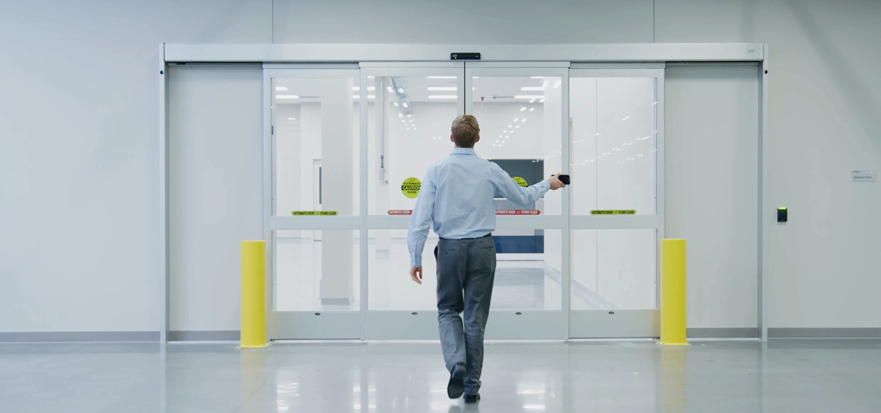
What benefits does HID Mobile Access offer your organization?

Slide 12
Why HID Mobile Access? Convenient – Process Efficient - Innovative
More Choice | More Freedom | More Confidence
Where security and convenience meet | Intuitive web experience for managing secure identities | Breakthrough technologies for best-in-class security and privacy protection
Just use your phone or smartwatch to open the door “Tap” and/or “Twist and Go” experience interaction Go keyless, or go parallel with physical access cards or fobs. Lost devices are reported quicker than lost cards | Enhance existing physical card/key processes Issue Mobile IDs through secure, cloud-based management for a new era in access control Change to reduce carbon footprint Easy access for remote workers | Select the right reader engagement for You: long read range or short read range Flexible reader placement (less visible, vandal proof, secure side of door) Instill confidence with best-in-class security and privacy protection

Slide 13
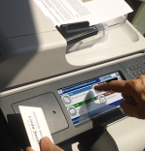
Enterprise Readiness: HID Mobile Access
Secure Network Access
Secure
Print Release
Track Time & Attendance
Parking & Gate Control
HID Mobile Access® Experience a smarter, more connected environment
Physical Access Control
Lock & Cabinet Access Control
Cashless
Applications

Slide 14
HID Mobile Access – Go Mobile

Slide 15
Components of HID Mobile Access
Wireless Mobile ID Management
Physical Access Control

Slide 17
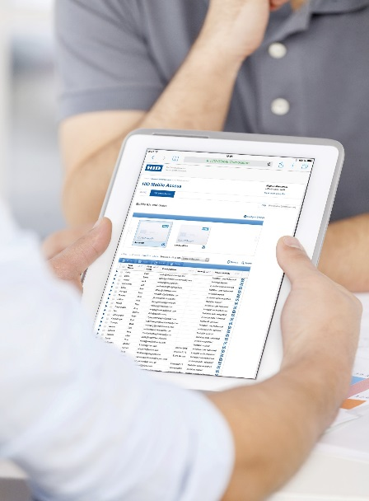
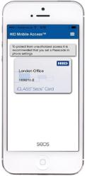
HID Mobile Access® Four easy steps – Ready To Use
Your Access Control System
(PACS ID inserted manually)
1 End User Administrator manages users and Mobile IDs via the HID Mobile Access Portal
2 Mobile ID is transferred into device over the air
3 “Tap” or
“Twist & Go” via HID Mobile App
4 iCLASS SE Reader sends credential data to panel for validation

Slide 19
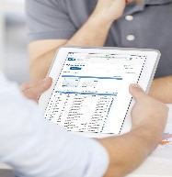
HID Mobile Access® Four easy steps – Custom Integration
HIDMA Portal
Onboarding, Admin, ACS set-up, Inventory (co-existance)
HID Mobile Access Portal API
Your Access Control System. Frictionless PACS ID assignment
(3rd product capability)
1 End User Security Administrator manages users, access rights and Mobile IDs via their own Access Control System
2 Mobile ID is transferred into device over the air
3 “Tap” or
“Twist & Go” via HID Mobile App (or 3rd party app via SDK)
4 iCLASS SE Reader sends credential data to panel for validation

Slide 20
Smart Devices and Opening Modes

Slide 21
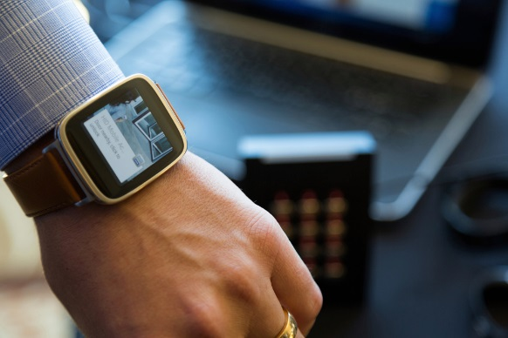
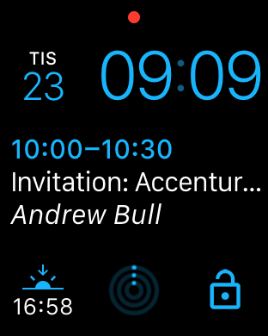
HID Mobile Access Now with SmartWatch
Learn more: Download today. SmartWatch (Apple Watch and Android Wear) in companion mode

Slide 22
SmartPhone: Tap or “Twist and Go”? Configure reader via Android Config App:
Tap (close range)
Twist and Go (longer range)
Garages
Entry gates
Tap-in
Meeting zones
Warehouses
Loading bays
Combined security
Turnstiles
Remote buildings

Slide 23
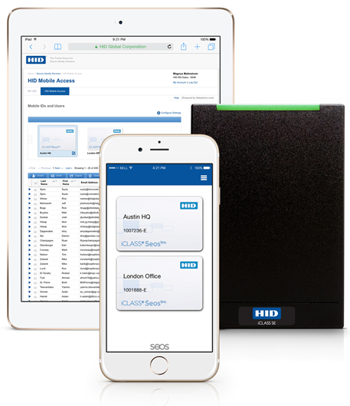
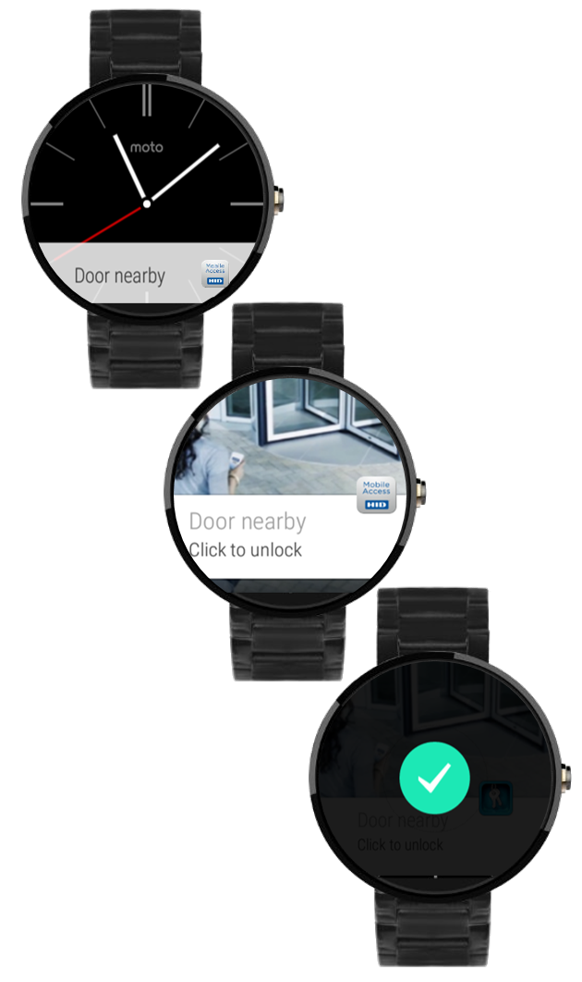
Devices Supported (examples)
Android 4.4+ (NFC & BLE)
Google Nexus 5, Nexus 6, Nexus 7
Samsung Galaxy
Note 3, Note 4
S4, S4 Plus, S5, S6
Sony Xperia Z2, Z3, Z4, Z5
HTC One
LG G4
iOS 8+ with Bluetooth Smart
iPhone: 4S, 5, 5C, 5S, 6, 6 Plus, 6S, 6S Plus
iPad: Air, Mini, 3rd & 4th gen
Smart Watches
Watch OS: Apple Watch
Android Wear: Moto 360, LG Watch, Sony 3
Notes:
HID Mobile Access supports Android and iOS devices. The devices on this list have been tested and verified – but other devices may work, but are not officially supported.
There may be slight difference in gesture control and read distance across OS and devices (even from one manufacturer) due to the hardware components (antenna, chip sets,..) used.
Windows Phone is not currently supported, but the next version of the operating system due out in 2015 will most likely include the features and functionalities we need to develop a compatible App. We will be looking into this at this time.

Slide 24
Privacy & Data Protection

Slide 25
HID Global® is committed to the protection of our customer data and to deliver a first class service that lives up to global demand
Years of protection physical access evolved to mobile protection

Slide 26
The EU Privacy Principle of HID Mobile Access
“HID Global follows the EU Data Protection Directive 95/46/EC, which allows for personal data to be transferred from the EU to outside the EU/EEA, provided that the individual (the “data subject”) has given his/her unambiguous consent to the transfer.”

Slide 27
Privacy and Data Protection
HID Global only collects information which is required for service
Ensure reciprocity: mutual information sharing
End-User: Name, Email for You to invite Your users
Device make / model, app version to provide better service
Informative and valid privacy policy (option to accept or not accept)
Mutual exchange of information. You have access to the data in portal
HID compliance to standards
No sensitive personal data is stored, such as financial or health care information
Portal Administrators: Name, Email (User ID), password (stored encrypted), Phone Number only for Two Factor Authentication to log-in

Slide 28
Best Practice – Data Protection
Continuous commitment
Ensure privacy and security
Use of open standards to enable and enhance cybersecurity
2 factor authentication for log-in to portal
Strong password control (length, complexity, store encrypted)
Passed penetration testing with leading, independent 3rd parties
Security control framework
Passed network vulnerability threat assessments
TLS protection from Your browser to HID application
Inactivity log-out
Breakthrough Seos® credential technology protects privacy as no identity information can be read
Internal training on privacy priorities, principles, policies, and processes
Design, code, review and testing

Slide 29
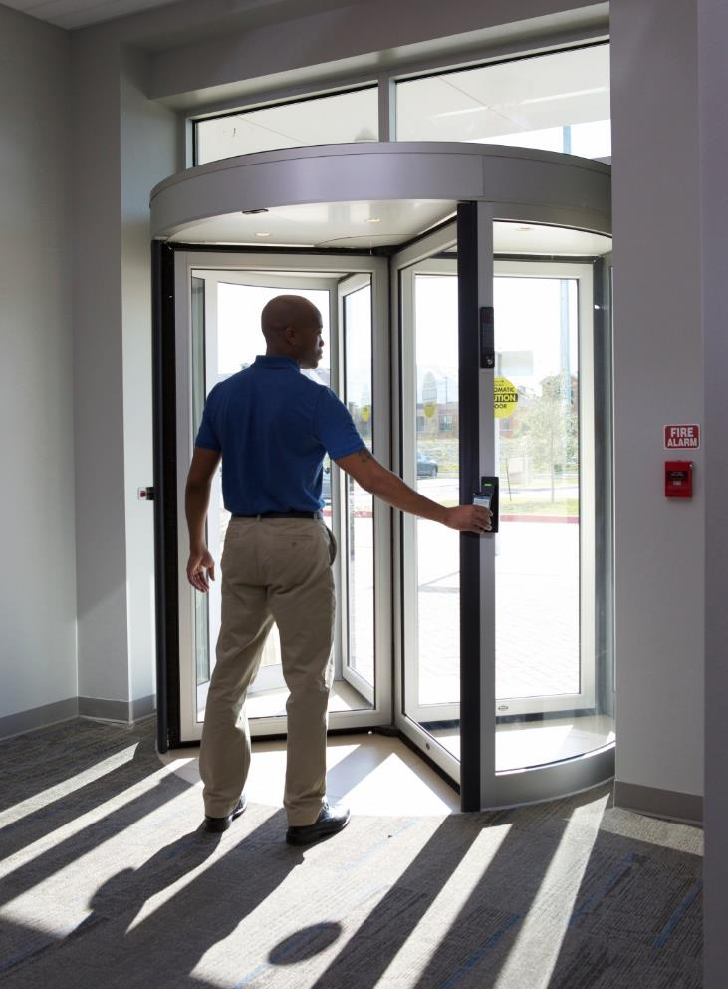
Learn More
HID Mobile Access is easy to get and install and allow you to discover convenience today
HID Global technical support and web resources guide you
Notes:
The Group’s product leadership is achieved through the continuous development of products offering enhanced customer value and lower product costs. A key activity for achieving this is the use of common product platforms with fewer components.
New products are also being developed in close collaboration with ASSA ABLOY’s end-users and distributors to enhance customer value. The product development process has been streamlined by implementing a clearly defined common development process and by separating the maintenance and improvement of existing products from new development.

Slide 30
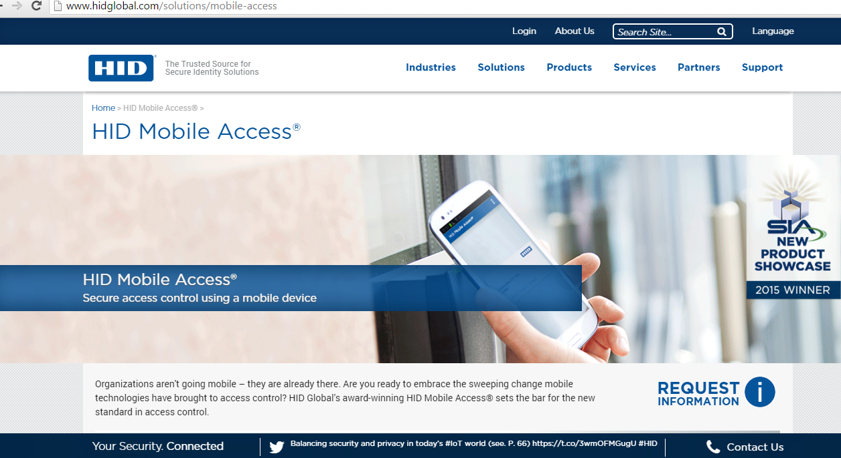
Mobile Access on hidglobal.com
HID Mobile Access on hidglobal.com
SDK on Developer Center and APP Partner Portal

Slide 31
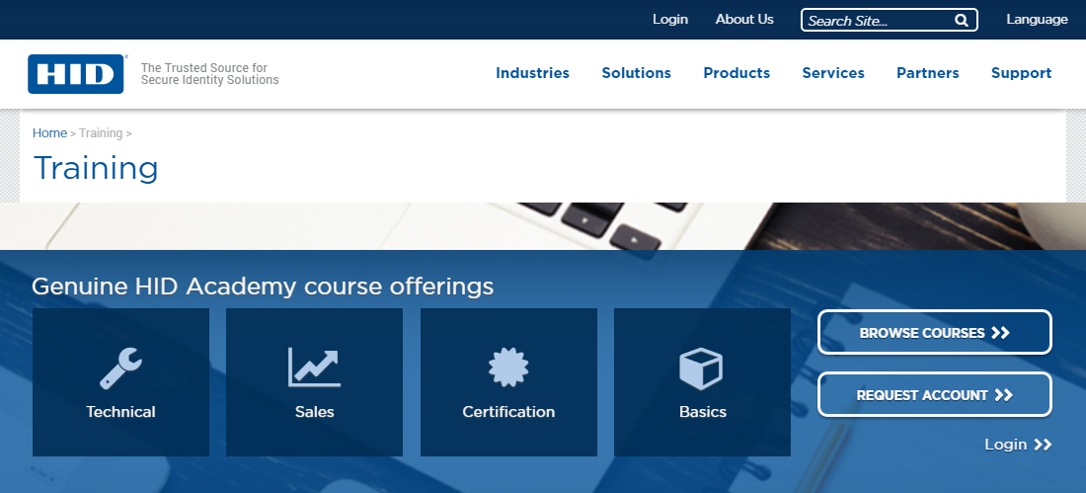
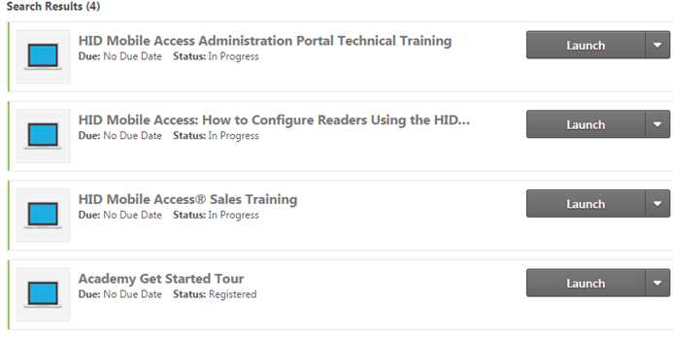
The Place to Go – Academy Training
Academy Online Training
Sales and Technical Training available
Partners: available via Genuine HID Academy Learning Center
HID MA Positioning, Discovery Questions, Ordering, Portal Administration etc.
How to install and configure reader?
To Register Visit:
http://www.hidglobal.com/training

Slide 32
hidglobal.com

